Slide 1

Andreas Wanke, Melanie Thie
Sustainable
Campus Management
at Freie Universität Berlin
Campus Walking Tour
5th UGAF Workshop, Berlin
2015/03/25 – 2015/03/27
Notes:
Welcome to the campus walking tour. Before we start, I want to give you some basic information about the campus, the dimension of energy consumption and the main instruments of our sustainability management.

Slide 2
Campus Overview

Slide 3
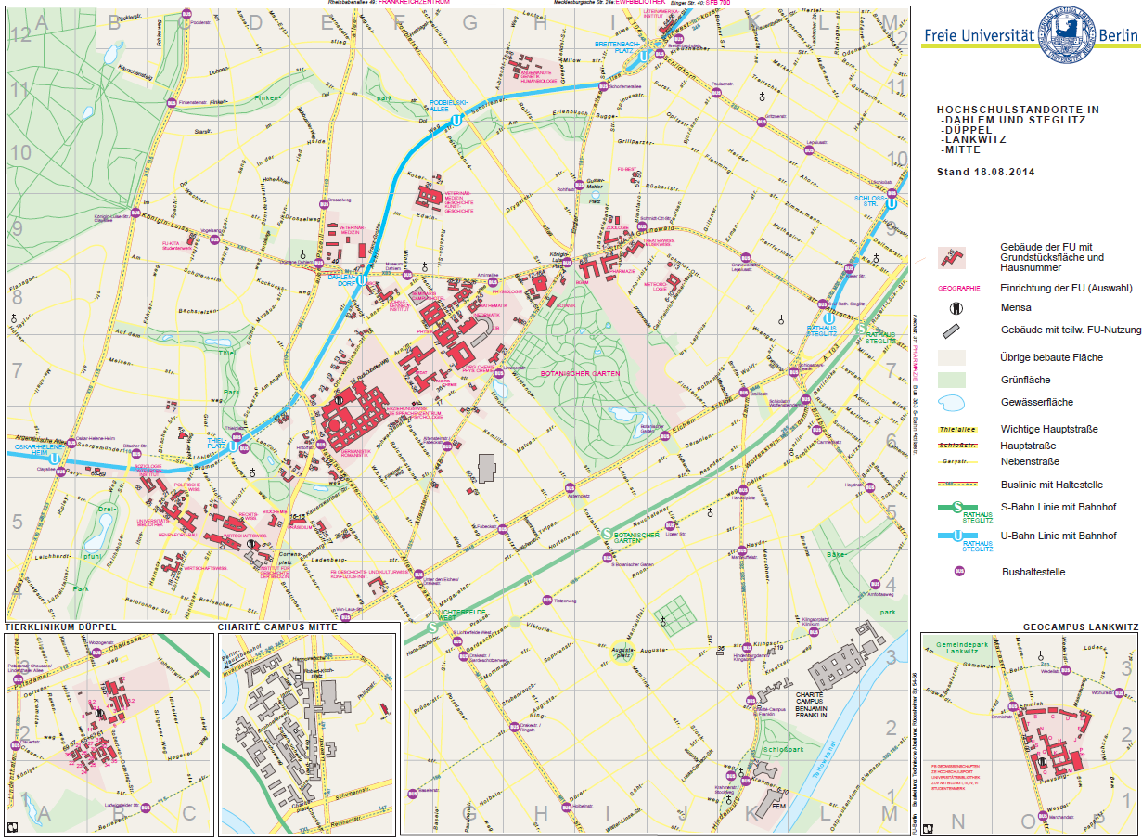
founded in 1948
33,000 students
(incl. 4,300 PhD students)
5,100 employees (4,230 FTE),
incl. 349 professors
(plus 110 junior professors)
ca. 200 buildings with 530.000 m²
government grant: 298.5 M €
third-party funds: 124 M €
energy costs
13,4 M €
water costs
1,3 M €
disposal costs
0,37 M €
Datas: students 2015, employees end of 2014, energy costs 2014, water costs 2012, disposal costs 2013
Notes:
We start with some key numbers about our university. With 33,000 students and more than 5000 employees Freie Univeristät is the biggest university in Berlin and one of the 10 biggest in Germany. FU has a budget of 420 Million Euros including the third-funding funds of 124 Million Euro. It has 15 departments, schools and central institutes offering more than 160 study programmes in all disciplines except for engineering.
We currently have about 200 buildings with a total usage surface of 500,000 square meters on 3 campuses. At our 2 external campuses are the geo sciences and the veterinary medicine. Until 2013 we used additional buildings at Humbold Universität for the veterinaries, in 2014 they moved into a new highly engineered building on the external campus.
We have to pay over 13 Million Euro per year for electricity and heating, 1.3 million for water supply and nearly 400 thousand for disposals. This shows that energy must be the most important factor of our environmental management.

Slide 4
EnErgy Balance
Notes:
Let‘s take a short look on the university‘s energy balance.

Slide 5
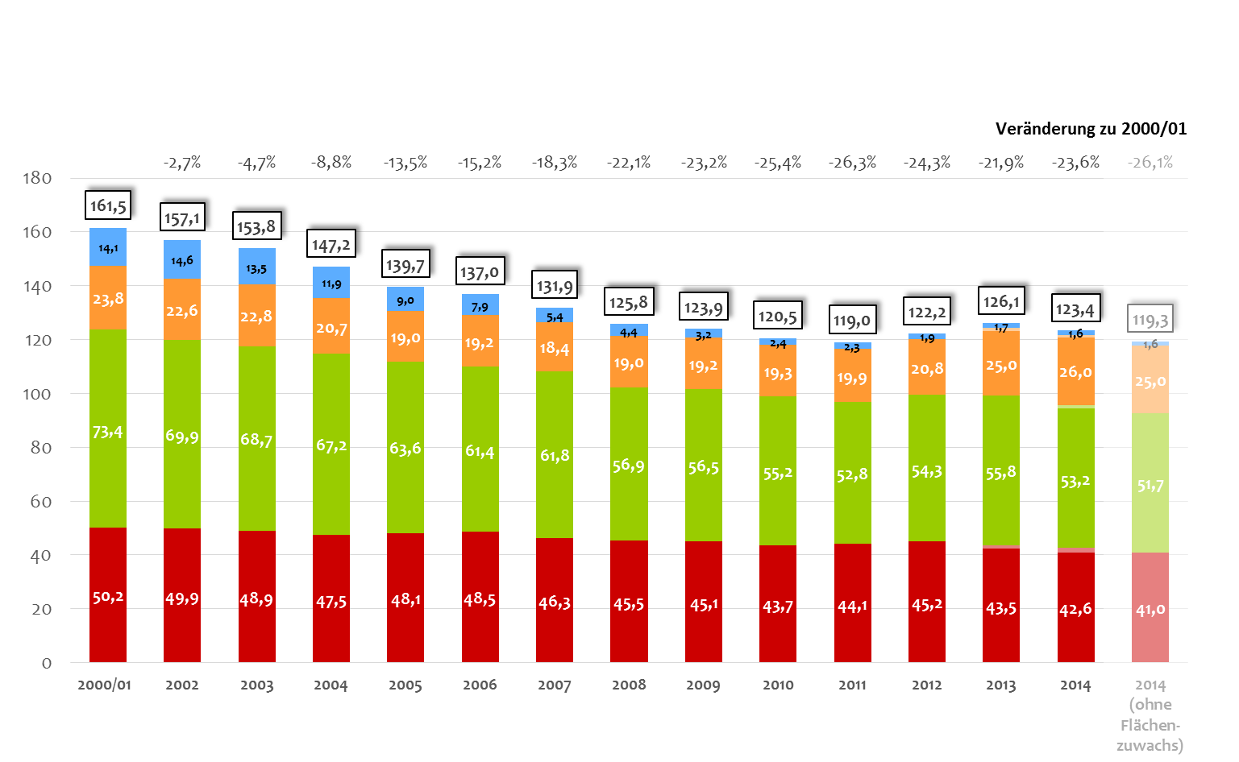
Final Energy Procurement 2000 – 2014 in million kWh, heating datas weather adjusted
change to 2000/01
-23,6 %
(-26,1%)
-88,8%
(-88,8%)
heating
oil
+9,5%
(+5,6%)
natural
gas
-27,5%
(-29,5%)
district
heating
-15,2%
(-18,4%)
power
2014
(without area growth)
Cost Reduction 2014 (compared to baseline 2000/01): 3.8 Mill. Euro
Notes:
This graph shows the university‘s energy procurement over the last 13 years. You can clearly see the result of our energy efficiency activities. We have reduced the energy procurement by nearly 40 Million kWh compared to 2000. This corresponds to a decrease of almost 24% including our two new big buildings – one of which you will see later. Without this area growth we even have a reduction of over 26%.
Without energy efficient measures the university’s energy costs would have been 3.5 Million Euro higher.
Until 2011 we had a reduction of energy consumption of yearly 3% on average. After this we came to a more difficult period with increasing energy use. Now we have reached a point where additional energy savings become more and more difficult. But last year we reached the level of 2011 again if we leave out our new buildings. We assume we can reduce our energy consumption by further 10 percent.
Mentionable is the reduction of heating oil by nearly 90%. In most buildings we convert the oil-heating systems to gas or district heating and could nearly trim back the whole oil consumption. This year we want to convert the last 10 oil supplied buildings.
The natural gas consumption increases since 2013 notably again. There is a simple explanation for this: In this year our first two block heat and power plants came on steam. They run with gas and produce heating and power for our two external campuses. With them we have a very efficient power supply.
In the thermal sector we saved more energy (more than one quarter) than in the power sector (only 15% reduction). Savings in the power sector are generally more difficult. On the one hand due to the very fragmented structure of electricity appliances. On the other hand because of the fast growing use of power in some sectors such as IT or cooling – particular in labs, greenhouses and data centres.

Slide 6
Energy Prices
2003-2014 in cent/kWh, prediction for 2015
power +125% natural gas +76% district heating +61% heating oil+106%
* prediction EWS
Notes:
Here you see an overview of the development of the energy prices of the university.
It shows again the need to focus on the electricity consumption. Last year we paid over 19.4 cent per kWh for power. This is a cost increase of over 125% since 2003. Just the cost difference of 2.9 cent between 2012 and 2014 led to a cost increase of 1.2 million Euro for the university.
This year we see a small drop in prices.

Slide 7
KEY INstuments
Notes:
On the next slide I’ll show you the key instruments of our sustainability management.

Slide 8
Chronology
Certification according to ISO 14001 (2004 – 2013)
First Closing of University (Christmas / New Year)
Transformation to Sustainability Management
Energy Controlling
First Photovoltaic Plant
Initiative Sustain It!
2001
2004
2007
2008
2010
2012
2013
2014
2003
2008
2010
2011
2015
Bonus Scheme for Energy Saving
Green IT Programme
Block Heat and Power Plants (CHP)
University Alliance
for Sustainability
Energy Efficiency Programmes (2003 – 2011)
Climate Protection Agreement
Notes:
The quality of energy controlling is the foundation for successful energy management. Thus our first action was to close metering gaps and to introduce an energy database. Most meters are read monthly by our operational staff. In 2010 we started with an onlinesystem and began to install remote readable meters. This gives us the possibility to better understand the energy usage in the buildings, to see inconstancies and consumption increases faster and to analyse them deeper. The whole university will be integrated in the online system in the next year.
The second key factor are the energy efficiency programmes for our buildings. The main focus was on energy saving measures in the engineering sector, especially the modernisation of heating systems combined with new regulation technologies in the ventilation sector. Furthermore we insulated flat roofs and upper story ceilings. We spent 1.2 – 2 million Euros annually until 2011 for this. The reductions in heating were between 15 and 50 percent – averaged at 33%. Today, 90% of the university’s building area is heated by modernised energy efficient heating systems.
Another and very important key factor is the internal bonus scheme - started in 2007. IT gives the departments direct financial incentives to implement their own energy saving measures. The departments receive an annual bonus from the university’s budget if their energy consumption falls below an agreed baseline. The bonus amounts 50% of the annual cost reductions. If they exceed the baseline, they have to bear 100% of the costs.
In 2010 we established a Green IT programme. The most important measures next to the sensitisation of staff include an energy efficient data centre cooling, improvements in procurement and the optimisation of the power management. In addition one main key] measure is the consolidation and centralisation of servers.
A more recent technical instrument are our installed block heat and power plants. With our two decentral CHPs we are now generating more than 3 million kWh electricity ourselves. They have very good ROI of 3 – 3.6 years. With these plants we could reduce our CO2 emission by 1,500 tons every year. Last year another smaller plant was added and this year the first bio gas CHP goes on steam in the botanical garden – as you heard yesterday.
Our newest element is the development of an university alliance for sustainability. Together with our four strategic partner universities we will develop teaching offers and research projects, and enable students as well as staff from research and administration to collaborate on all aspects of sustainability. For this whole institution approach the university got a financial funding of the German academic exchange service for the next 4 years. It is planned to organise research stays, spring schools, conferences and study and internship visits but also to bring the executive boards together as well.

Slide 9
Building of laws heat consumption, 2003 – 2014 in MWh
(2003: 139 kWh/m² - 2014: 43,5 kWh/m²)
optimisation of the heating system, user buttons for ventilation
bonus system,
environmental
teams
restauration of the building
envelope, new windows
Notes:
This slide illustrates one example of the effects of the implemented energy efficiency measures.
You see the heat consumption for heating and ventilation of the building of our law department. First from 2004 to 2005 we optimized the heating system with a hydraulic balancing, installed new thermostat valves, and equipped the lecture rooms with manual controls for the ventilation. Before that the ventilation was often running the whole day. Since this the lecturer can turn on the ventilation whenever it is needed – otherwise it is off. This measure led to a reduction in energy use of nearly 50%, that means 700 MWh per year. In 2008 we implemented the bonus system and established environmental teams – a further decrease of more than 20%. Then in 2009 followed the reconstruction of the whole building with new windows and a new thermal insulation. With this measures we decreased the specific heat consumption by 69% from nearly 140 kWh/ qm to less than 44 kWh/ qm. Now we are in the lower area of a low-energy house.
Interesting is the higher consumption in 2013. We couldn’t find an explanation for this outlier. With the Onlinemonitoring we would have the possibility to see such negative trends earlier and to analyse them more deeply.

Slide 10
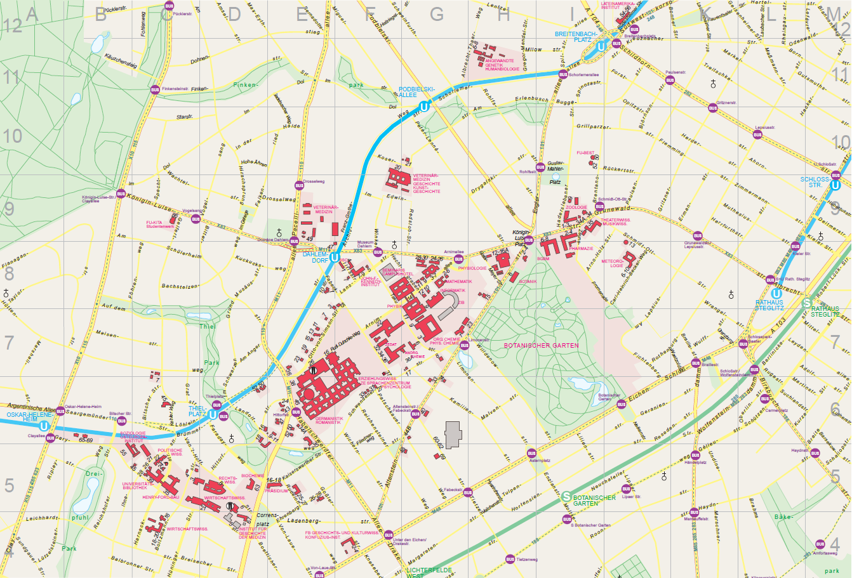
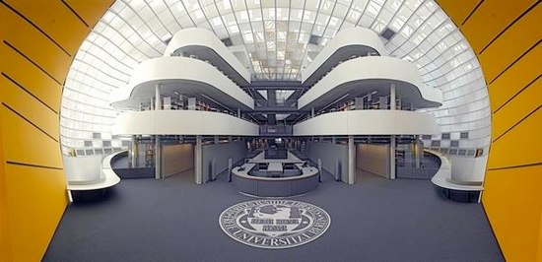
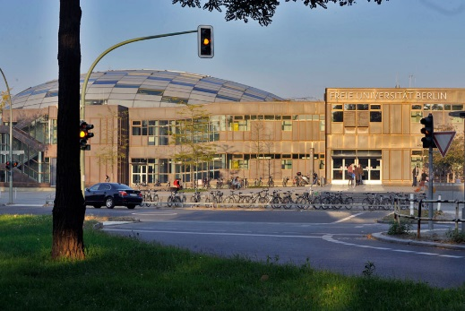
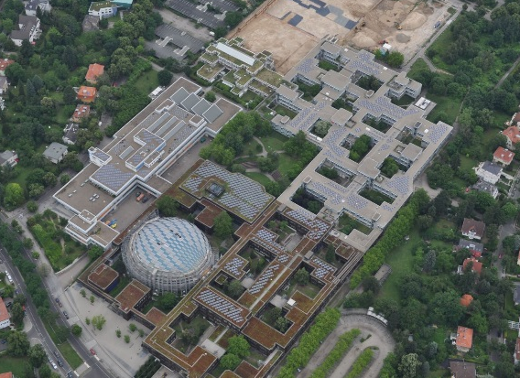
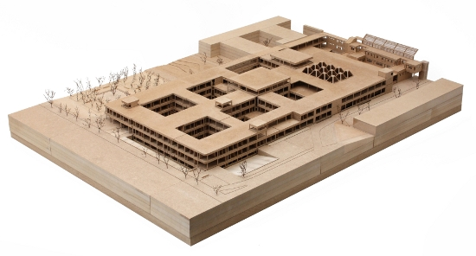
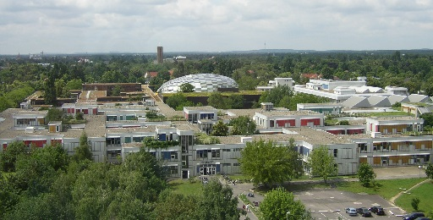
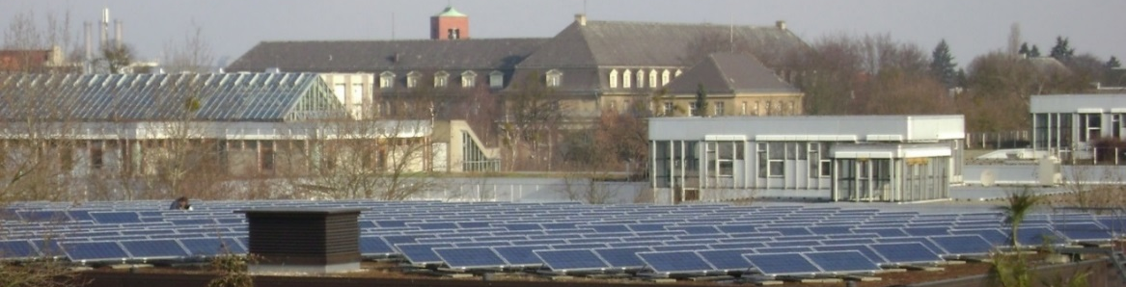
CAMPUS Tour
Notes:
Now, we are coming to our campus tour. We want to go onto the roof of this building with you where you can see one of the photovoltaic plants and have a great view over the campus. We will take a brief view into The Brain – the philological library. You will get information about the history of this building and we make a side trip to our new building where the architect and the planner will answer our questions.
Please split into two/three groups of maximum 25 people. One group will start with the new building. One with the PV.
Because of the large number of participants we offer a third tour. There you hear something about the sustainability efforts of the Studentenwerk.

Slide 11
  Coordinator of Sustainability &
  Energy Management
  Andreas Wanke
  +4930 / 83852254
  andreas.wanke@fu-berlin.de
  Sustainability Management,
  Energy Controlling & Green IT
  Melanie Thie
  +4930 / 83857551
  melanie.thie@fu-berlin.de

Slide 12
Energy Consumption, Costs, CO₂-Emissions
2014 in %

Slide 13
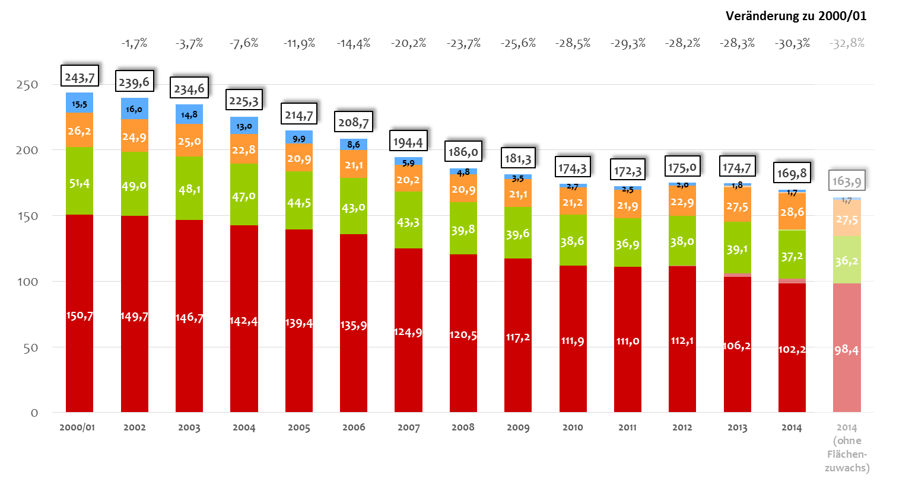
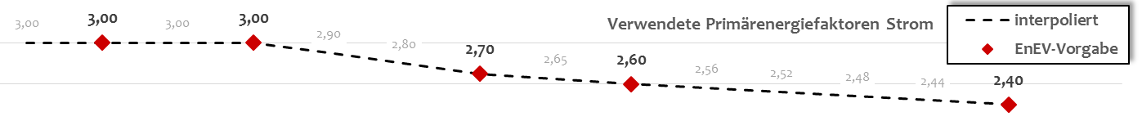
Primary Energy Input 2000 – 2014 in million kWh, heating datas weather adjusted, PE-factors with GEMIS
change to 2000/01
-30,3 %
(-32,8%)
-88,8%
(-88,8%)
heating
oil
+9,5%
(+5,3%)
natural
Gas
-27,5%
(-29,5%)
district
heating
-32,2%
(-34,7%)
power
2014
(without
area
growth)
Used primary energy factors power
- - - interpolated
 EnEV-specification
Notes:
Here we throw a glance on the primary energy input of the university. This shows other proportion of the savings. Here we have a percental decline of over 30%. That’s because of the high … of the power production.
TEXT…

Slide 14
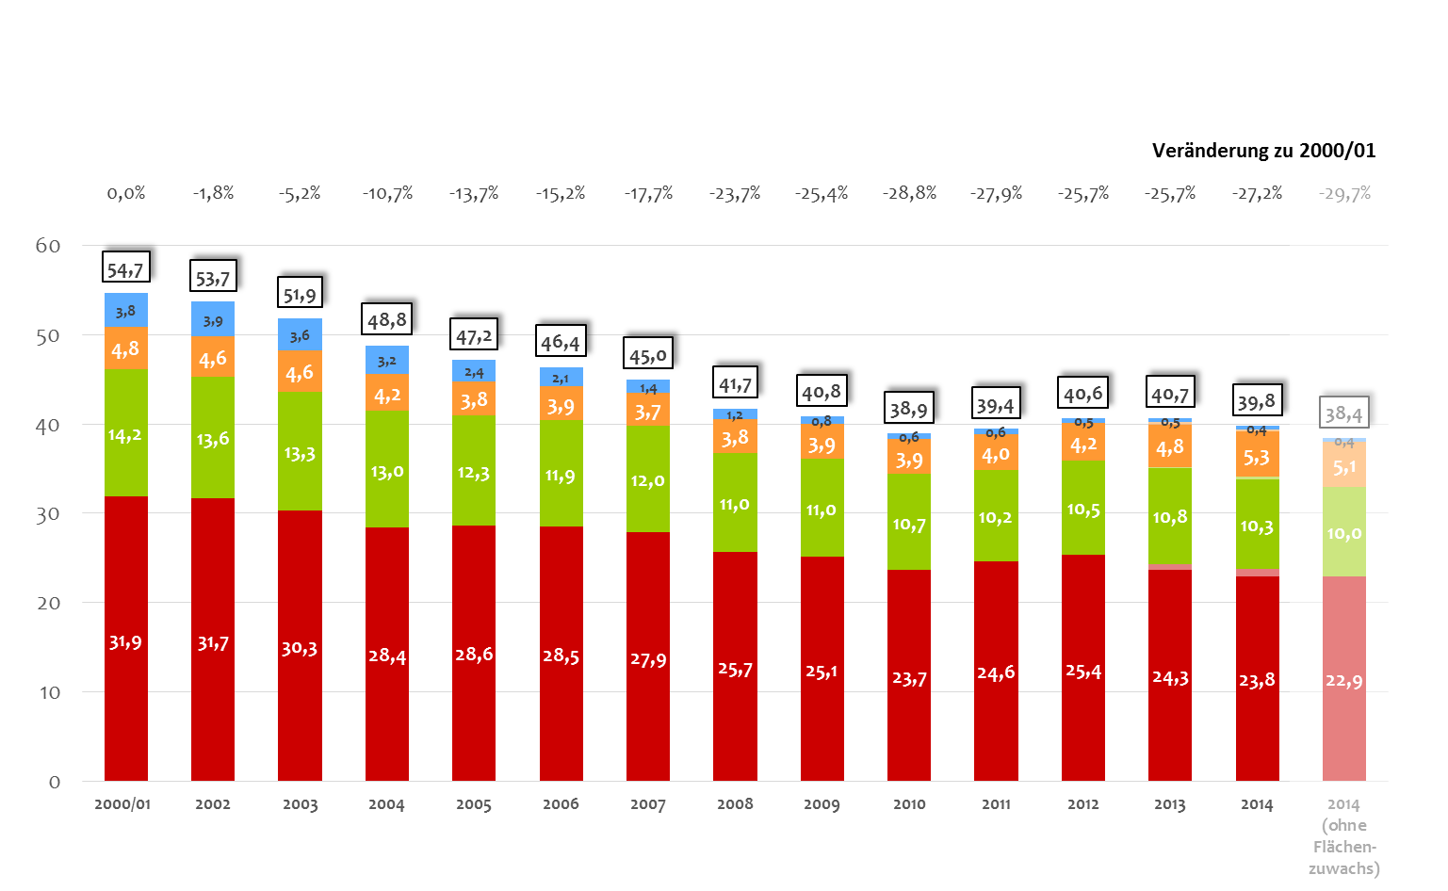
CO₂–Emissions 2000 – 2014 in 1.000 tons, with GEMIS-factors
change to 2000/01
-27,2 %
(-29,7%)
-88,8%
(-88,8%)
heating
oil
+9,5%
(+5,3%)
natural
gas
-27,5%
(-29,5%)
district
heating
-25,4%
(-28,1%)
strom
2014
(without area growth)
Notes:
And here you see our CO2-balance. We are emitting nearly 15.000 tons less CO2 inclusive the area growth and over 16.000 except it.
TEXT …

Slide 15
Heat Consumption of selected buildings absolute in MWh und specific in kWh/m² (2013)
specific heat consumtion in kWh/qm
Natural sciences
Humanities

