Slide 1
Every day practices and knowledge. How to call whom for participation?
Inka Bormann

Slide 2
…how to better combine talk and action
…always the usual suspects!
…they do not understand what I wish them to do…
…no idea of how to breach killer phrases
…I don‘t know why they do not participate

Slide 3
Preliminaries
Among others, we think that education and communication are crucial leverage points to move ahead on the path towards sustainable development
However, unilateral instruction or information is much too less and unproductive;
it seems an inconducive starting point on the long tour towards sustainable development

Slide 4
Preliminaries
Unfortunately, the causality between knowledge, consciousness and action has not been proven.
Thus, we need alternative ways to think about how to support sustainable actions.
Objectives of our session this morning
shifting away from a view on deficits in knowledge towards a view on resources embeded in practices
becoming aware of and value different needs and burdens of people – but typed!
discussing about leverage points to diversify modes of communication and participation in HEI

Slide 5
Outline
Relation between knowledge and practices
Heterogeneous practices and life styles
Inherent leverage points
Target-group appropriate offers for participation

Slide 6
Outline
Relation between knowledge and practices
Heterogeneous practices and life styles
Inherent leverage points
Target-group appropriate offers for participation
WHY
WHAT
HOW
CONCLUSIONS

Slide 7
WHY
Relation between knowledge and practices
Instead
commmunicating and teaching knowledge concerning (non) sustainable development issues
…from knowledge
to
action
acting sustainable
in every day life

Slide 8
WHY
Relation between knowledge and practices
Instead
commmunicating and teaching knowledge concerning (non) sustainable development issues
…to knowledge
from
action
becoming aware of implict sustainable practices in every day life

Slide 9
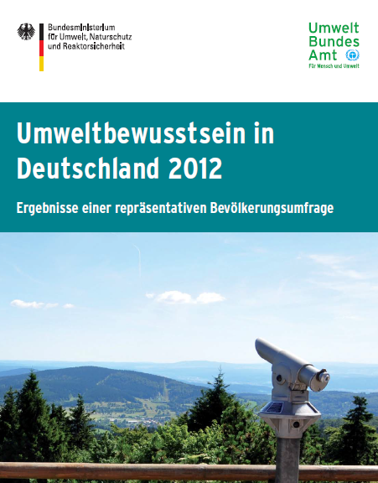
WHY
Relation between knowledge and practices
Overview of findings from representative study
on environmental consciousness
in Germany, 2012 (N=2000;
on behalf of Federal Environmental Agency)
  four ranges of action
  (residing, housekeeping, mobility, purchasing)
  types of every day life styles
  thoughts on specific offers of
  communication and education, incentives

Slide 10
WHY
Relation between knowledge and practices
But what has a German wide representative study on environmental consciousness to do with members of HEI and what can be gained from this study by experts from all over the world?
We assume, that at least some of these every day life style types
are to be found among the members of HEI.
To know of these might be eye-opening concerning the introductory
observations/problems…

Slide 11
WHY
Relation between knowledge and practices
„From knowledge to action“
„From action to knowledge“
(Vgl. Mandl/Gruber/Renkl 1994; Renkl 1996; Lantermann 1999)
(vgl. Kruse 2013; John 2012)

Slide 12
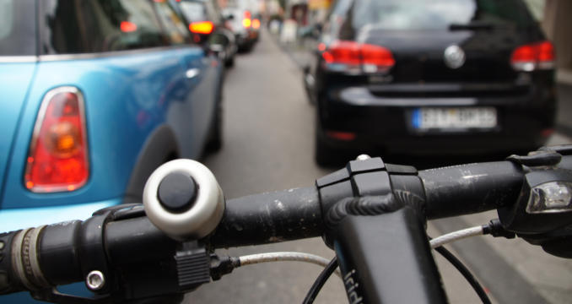
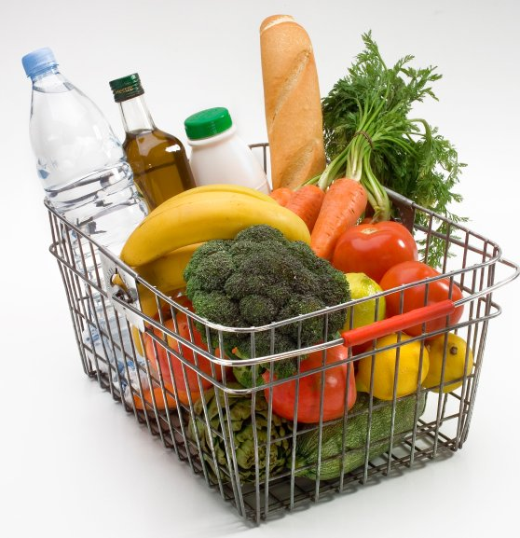

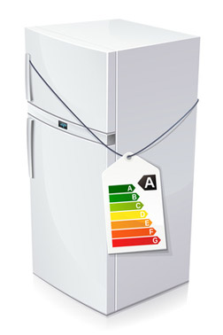

WHAT
Heterogeneous practices and life styles
Mobility
Free driving for free citizens?
Purchase of groceries
What you see is what you get?
Housekeeping
Saving – not later than… now!
Living
My home is my castle…

Slide 13
WHAT
Heterogeneous types of every day life (Otte 2004)
high
Established Conservatives
(2%)
Established Liberals
(10%)
Reflectives
(4%)
middle
Conventionals
(7%)
Adaptive Mainstream
(26%)
Hedonists
(7%)
Level of living/Living standard
low
Traditional Workers (10%)
Domestically Centered
(27%)
Entertainment Seekers
(7%)
traditional/
biographical closed
partly modern/
consolidated
modern/open
Modernity / biographical perspective

Slide 14
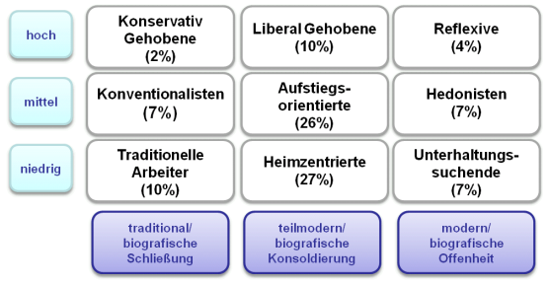

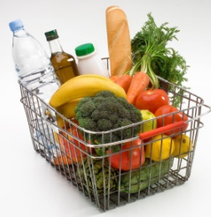
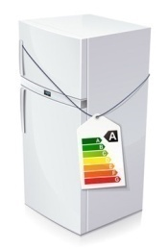
„Traditional workers“ (10%)
for ordinary paths mainly the car is used
above-average number of pedestrians
public transport is considered inconvenient
food is mainly purchased, if it meets functional criteria (price, durability etc.)
organic products too expensive
scepticism about Labels
dominance of economy
criteria of sustainability are no motive for Home Organization
usually live in a rented apartment

Slide 15
„Adaptive mainstream“ (26%)
relatively large number of users of public transport
openness to the hiring of cars and taking traffic calming measures
food is chosen mainly by quality-conscious and ethical criteria
are willing to spend money for the occasional purchase of organic products
practice environmental protection (waste separation, reduction in heating energy, etc.)
interest in energy efficiency labels when making purchasing decisions of household appliances
live very common in condominiums, in a house of one’s own or aspire at ownership

Slide 16
„Reflectives“ (4%)
use of all transportation
coping with everyday family-life with children imaginable also without a car
often buy organic or fair trade products
grocery Shopping according to ethically quality-conscious or traditionally-conscious criteria
behave environmentally friendly in the everyday practices of housekeeping
consider this also in the future as very significant
usually live in spacious condominiums or houses
are conscious about the environmental impact of houses

Slide 17
HOW
Inherent leverage points
„traditional workers“
present-oriented and focused on their own capabilities and current requirements
  → e.g. through offers of further education poorly achieved
  → upgrading of the practiced low-threshold, unconscious and environmentally-friendly procedures
    → locally enrooted sustainability movements

Slide 18
HOW
Inherent leverage points
„adaptive mainstream“
feasible, sensible dosed (environmental) measures which do not compete with other interests
institutional participation in educational offers
to stress "Added value“, such as a part of company training
support of extrinsic motivation for eco-conscious practices, for example by financial (company) or fiscal incentives.

Slide 19
HOW
Inherent leverage points
„reflectives“
comprehensive, far-reaching decisions, selfless, sometimes “risky” measures, more flexible regarding the environment
→ target group of resource-saving and socially innovative measures (e.g. collaborative use of equipment)

Slide 20
Typen alltäglicher Lebensführung (Otte 2004)
niedrige hohe Bereitschaft
Kommunikation für über Nachhaltigk.
wenig stark reflektierte Aktivität
politische soziale Treiber
hoch
Konservativ Gehobene
(2%)
Liberal Gehobene
(10%)
Reflexive
(4%)
mittel
Konventionalisten
(7%)
Aufstiegs-orientierte
(26%)
Hedonisten
(7%)
niedrig
Traditionelle Arbeiter
(10%)
Heimzentrierte (27%)
Unterhaltungs-suchende
(7%)
traditional/
biografische Schließung
teilmodern/ biografische Konsoldierung
modern/ biografische Offenheit

Slide 21
Questions? Discussion!
Thank you!
inka.bormann@fu-berlin.de

